Slide 1
Leads Mgmt. Process Review
2018-10-9

Slide 2
Summary
Lead Management Process has been running for 2 months. This is the review of all the detail process and their current status, mainly include:
Summary of the process
Lead generation status
Lead duplication status
Lead qualification status

Slide 3
Summary of the process
Scoring
Converted Leads
Generation
Deduplication
Qualification
Unqualified Leads
Duplicated Leads
Nurturing

Slide 4
Lead Generation
Entrance:
Inbound Call
Inbound Call
After Sales Service
Social Campaign
Voice Message
Word of Mouth
WeChat Follower
Manual Upload
Offline Event
Brochure Request
EC Journey
Weibo Ads
Toutiao Ads
SEM
GDT
Moment Ads
System Synchronize
Official Website
Moment Ads
Charket
WeChat
Social Campaign leads and voice message lead suppose to be upload by manually.
Word of mouth suppose to be information source.
Wechat follower leads suppose to be generated from chartket or mini program.

Slide 5
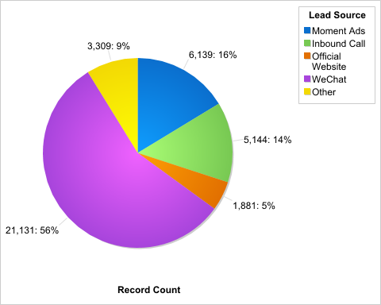
Lead Generation Status
More than half of the leads are generated by charket, plus 16% are from Moment ads, almost ¾ leads are from WECHAT.
Only ONE lead in system is from voice message
https://ap6.salesforce.com/00O0K00000ADj5y

Slide 6
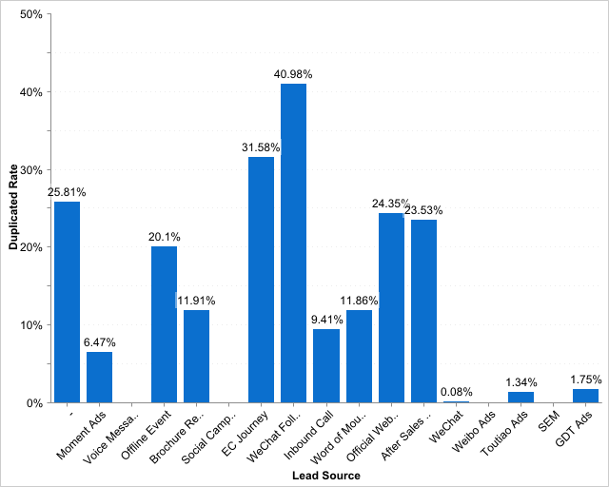
Lead Deduplication Status
Overall, 1,763(4.66%) leads are duplicated leads
More than 40% Wechat follower leads are duplicated.
https://ap6.salesforce.com/00O0K00000ADj5o

Slide 7
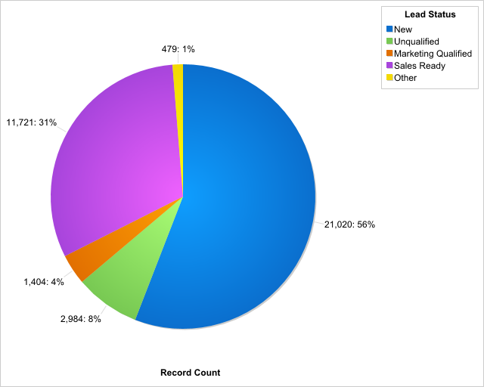
Leads Qualification Status
Overall, convert rate is 1%.
Less than 10% leads are completed follow up.
More than 23,000 leads are under (waiting) nurturing.
https://ap6.salesforce.com/00O0K00000ADj5K

Slide 8
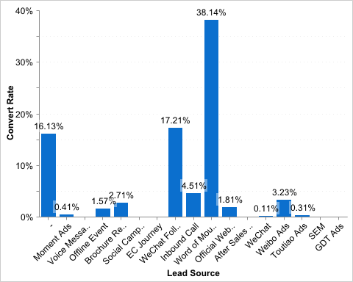
Leads Convert Status
The 1st convert rate is from word of mouth, over than 38% leads can be converted to quotation.
https://ap6.salesforce.com/00O0K00000ADj5K

Slide 9
To do
Leads Sync for more source. e.g. Brochure Request
Leads nurturing process.
Standardize end user operation.
Leads Scoring.

